Slide 1
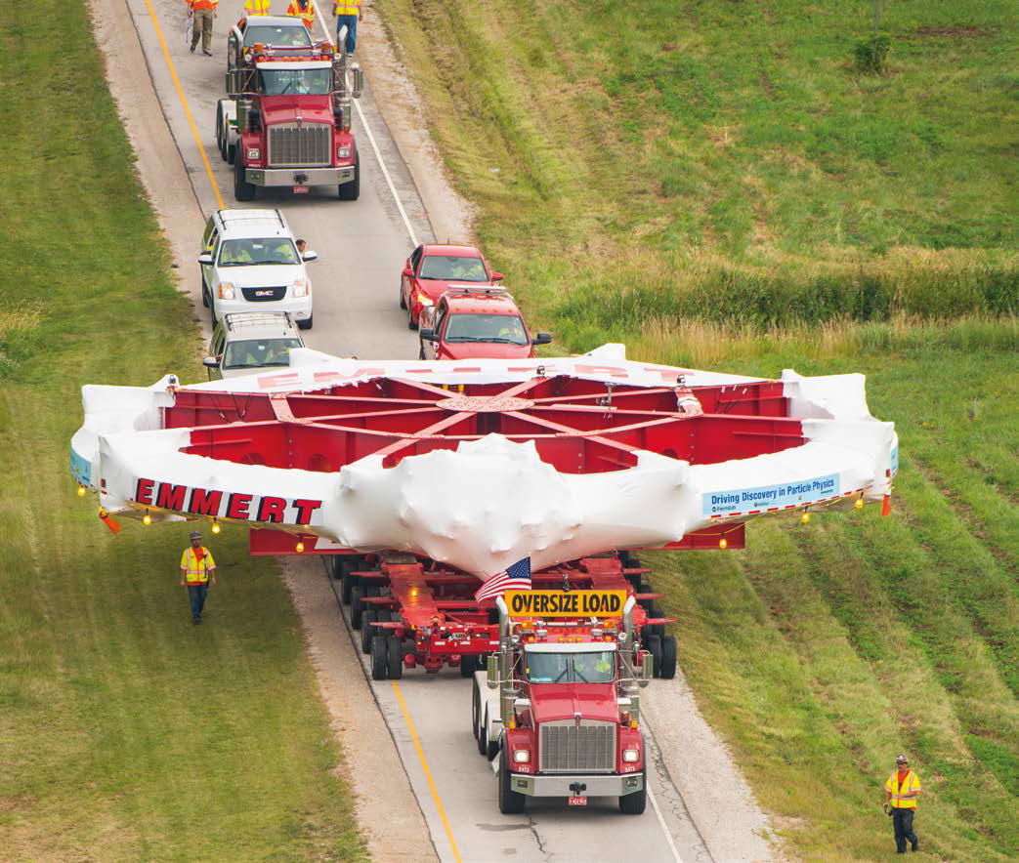
The Muon g-2 Experiment at FNAL
Franco Bedeschi, INFN – Pisa
MUSE Workshop
Pisa, September 2016
Outline
Introduction
History of g-2
Theory progress
Experiment
Conclusions

Slide 2
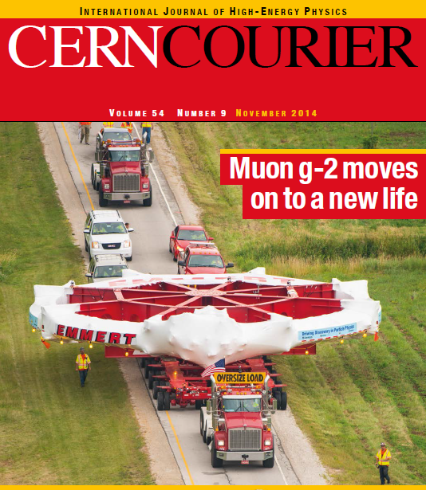
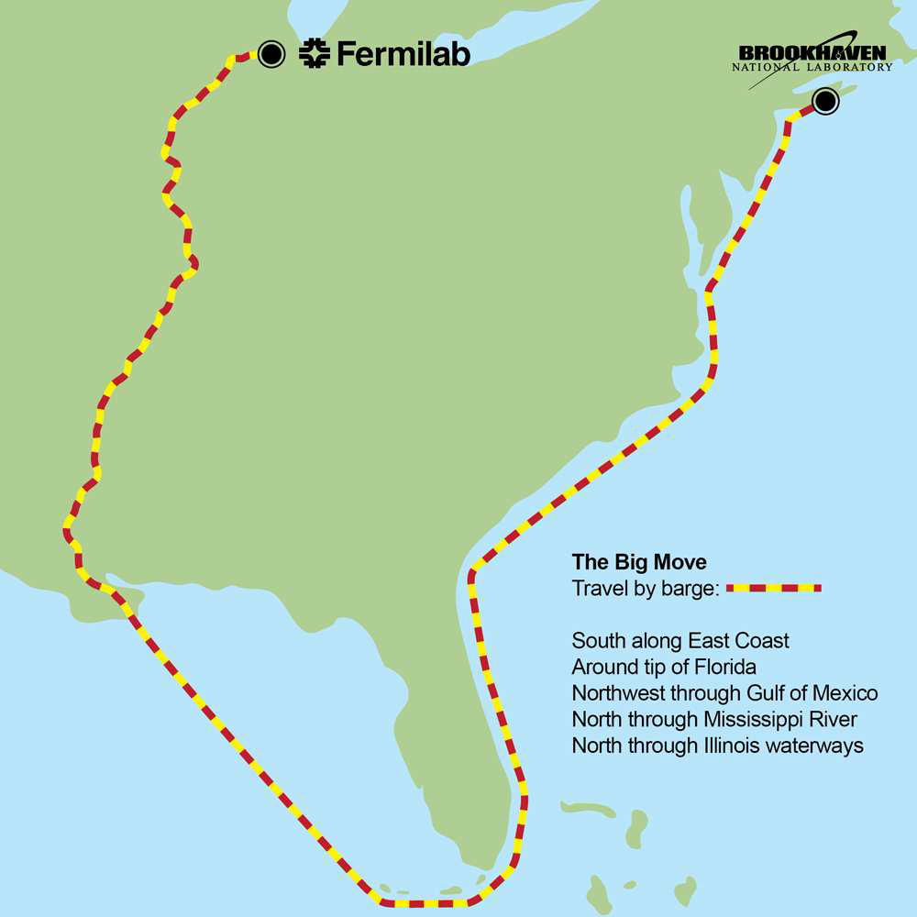
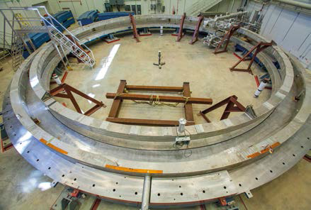
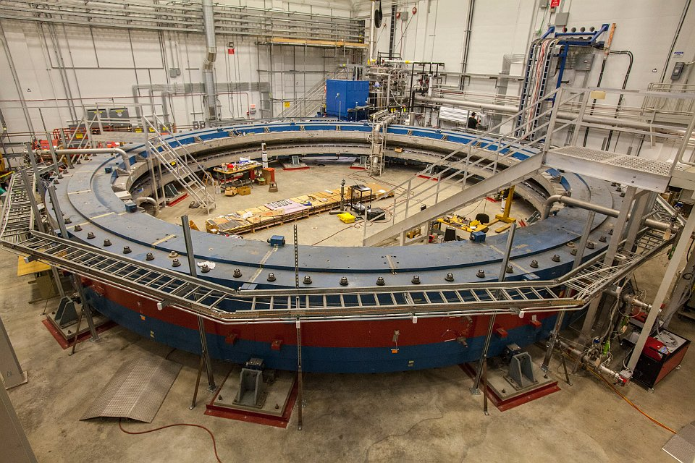
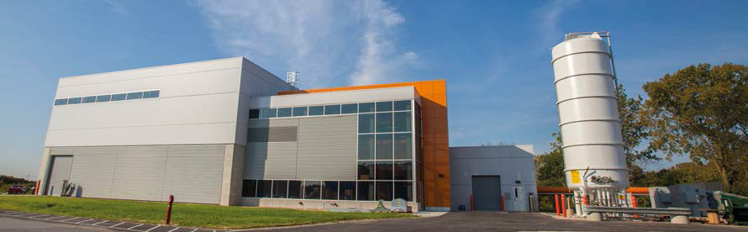

Slide 3
Muon g-2 experiment at FNAL
Improved measurement of the μ anomalous magnetic moment: a_{μ} = (g_{μ}-2)/2
Best previous measurement BNL-E821 (1997-2001)
  Error statistics limited
  Difference wrt. SM ~ 3σ (theory error ~ 5 x 10⁻¹⁰)
Goal of new FNAL experiment (E989) (x4 better)
  σ_{tot} = (1.2 stat. ⊕ 1.3 syst.) x 10⁻¹⁰ = 1.6 x 10⁻¹⁰
Assuming same central values (exp. & theory):
  SM – exp. difference:
    ~ 5σ if no improvement in theoretical determination
    ~ 8σ if theory improved by x2
G. W. Bennett et al.,
PRL 92, 161802 (2004).
L. Roberts, Chinese Phys. C
34, 741 (2010).

Slide 4
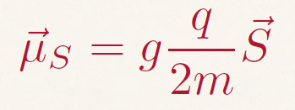
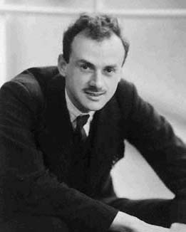
Basic definitions
Magnetic moment related to lepton spin, mass and charge
Tree level QED : g = 2 for all leptons
  Explained by Dirac in 1928
Tree level anomaly:
a = (g-2)/2 = 0
...only if pointlike
g_{p} ~ 5.6, g_{n} ~ -3.8
γ
μ
μ

Slide 5
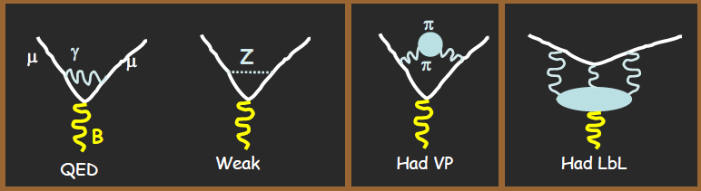
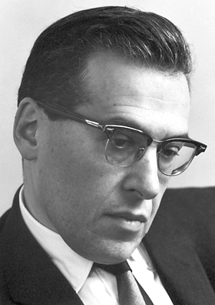
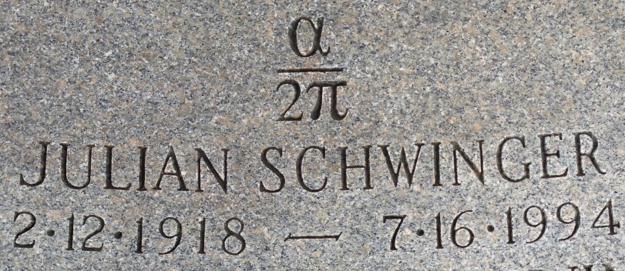

Higher orders (1)
Radiative corrections (challenging!) change the picture
  a ≠ 0
Schwinger (1948): 1 loop correction
$$a_{μ}= \frac{α}{2π}$$

Slide 6
Higher orders (2)
Higher order corrections depend on lepton mass
QED calculations becomes more complex:
  1 loop → 1 diagram analytic calculation
  2 loop → 7 diagrams analytic calculation
  3 loop → 72 diagrams analytic calculation
  4 loop → 891 diagrams numerical calculation
  5 loop → > 12,000 diagrams numerical calculation
    Contribution irrelevant compared to current experimental errors

Slide 7
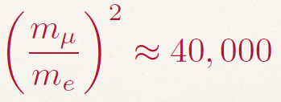
Other corrections
a_{μ} is affected by loops with W/Z or quarks (hadrons)
  Weak contribution small and precisely calculated
  Had VP and Had LBL are hard .... however
    Improvements and new approaches expected
  Contributions of virtual heavier particles (including new physics!) scale with lepton mass squared

Slide 8
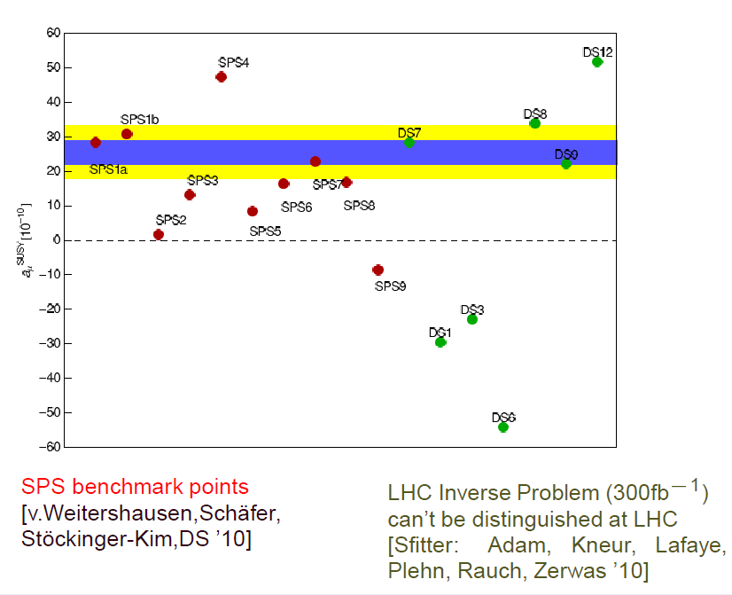
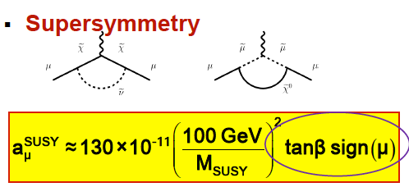
New physics sensitivity
New physics effects similar to weak contributions
  SUSY gives relevant contributions from χ± e χ⁰ not strongly bounded by LHC
  Presently a^{exp} – a^{th} ~ (245 ± 81) x 10⁻¹¹ (Kinoshita, Jul. 2014)
  Experimental precision close to new physics effects

Slide 9
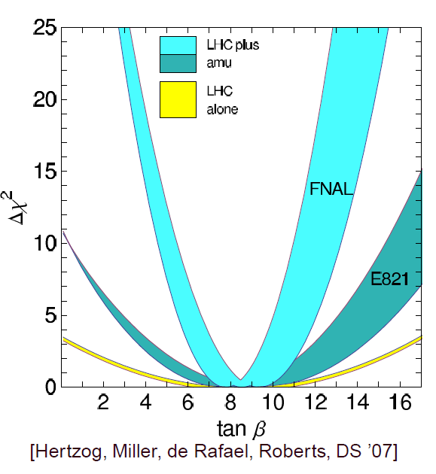
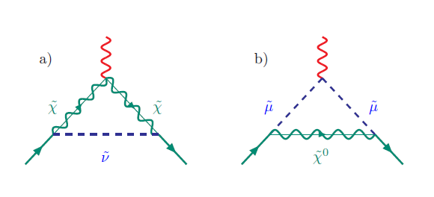
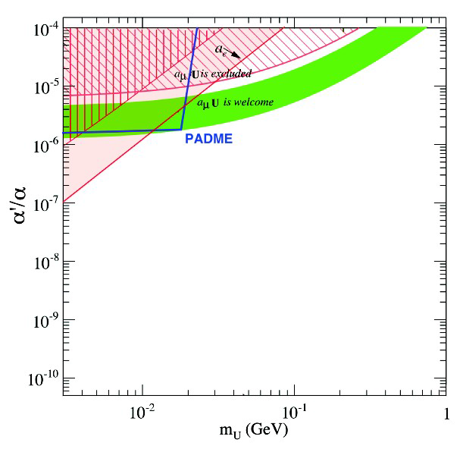
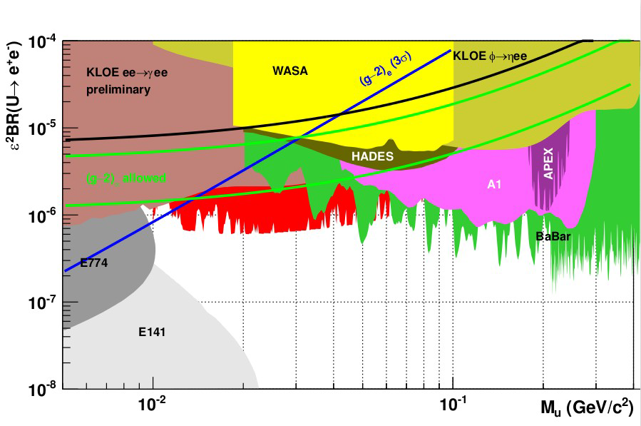
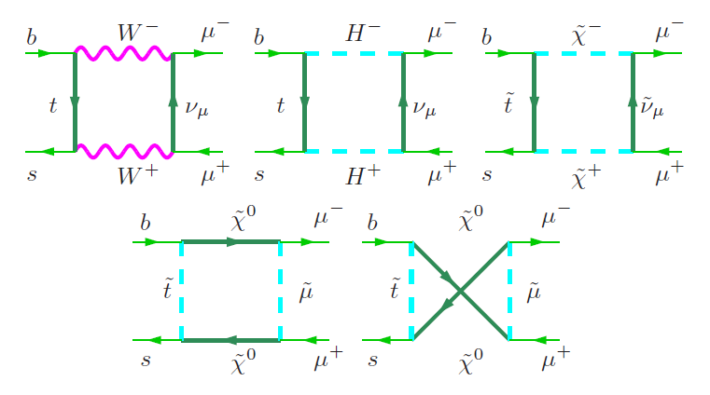
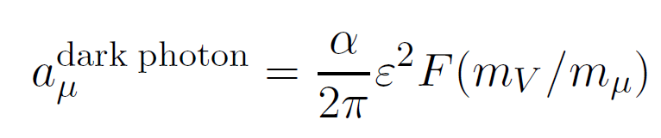
Relation with other measurements
Connected with other measurement of great interest
  Bs→μμ, μ◊eγ
  tan β
  Dark photon
g-2
  B→ μμ
Invisible decay
Visible decay

Slide 10
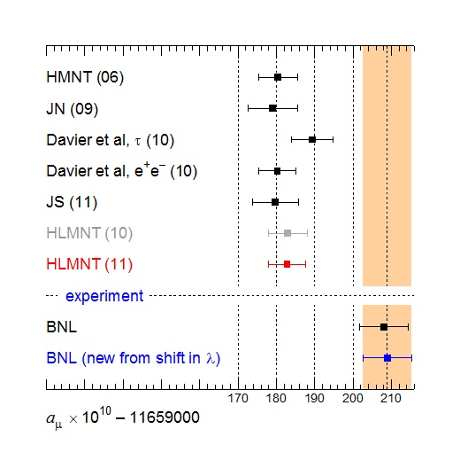
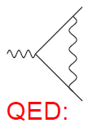
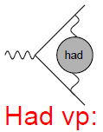
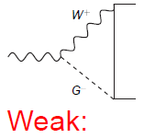
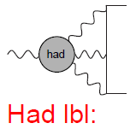
SM theory prediction (2014)
O(α⁵) complete
  11'658'471.9x10⁻¹⁰
  σ^{th} = 0.01x10⁻¹⁰
    T. Kinoshita, Cape Cod, July , 2014
2-loop
  15.4x10⁻¹⁰
  σ^{th} = 0.2x10⁻¹⁰
NNLO + exp.
  686.3x10⁻¹⁰
    σ^{th} = 2.3x10⁻¹⁰
    σ^{exp} = 3.7x10⁻¹⁰
  σ^{total} = 4.4x10⁻¹⁰
  σ^{total} = 3.3x10⁻¹⁰
NLO
  11.9x10⁻¹⁰ JN’09
    σ^{th} = 4.0x10⁻¹⁰
  10.8x 10⁻¹⁰ PRV’09
    σ^{th} = 2.6x10⁻¹⁰
Kinoshita (14)
Results – Jul 2014
Had LbL from:
JN’09: (11'659'185.5 ± 5.9) x10⁻¹⁰
PRV’09: (11'659'184.4 ± 5.1) x10⁻¹⁰ → 11’659’181.9 ± 4.2 (Davier16)

Slide 11
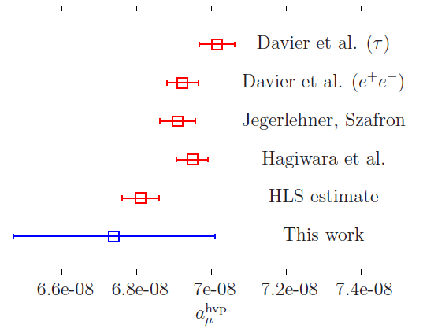
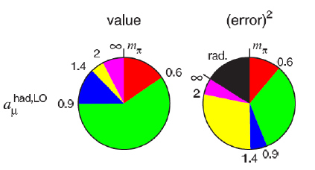
Potential theory improvements
VP
F. Burger et al.
arXiv:1311.3885
Had. VP:
  x2 on experimental error → new hardonic x-sections from KLOE2, BES-III, Belle2,VEPP2000 (→ see Lusiani, this wrksp)
  Improved radiative corrections in MC
  4 flavor lattice calculations presently 5 times worse, but are improving. arXiv:1311.3885v1 15 Nov ’13

Slide 12
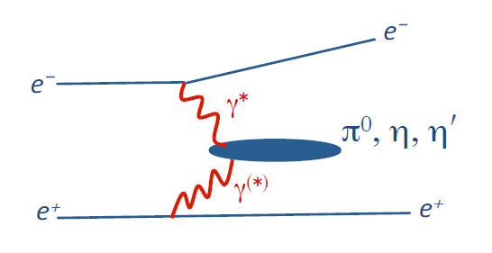
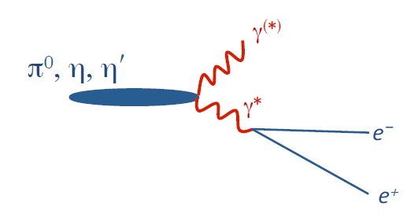
Potential theory improvements
HLbL
Had. LbL:
  Use dispersion relations to connect Had LbL contributions to experimental results.
    G. Colangelo et al., ‘Towards a data-driven analysis of hadronic light-by-light scattering’, Phys. Lett. B738, (2014) 6 (10 Nov. 2014)
    G. Colangelo et al., ‘Dispersion relation for hadronic light-by-light scattering and the muon g-2’, PoS CD15 (2016) 008
  Need γγ production or decay to 2γ → x2 theory error reduction expected
  Lattice calculations also started (Tom Blum 2014: arXiv:1407.2923)

Slide 13
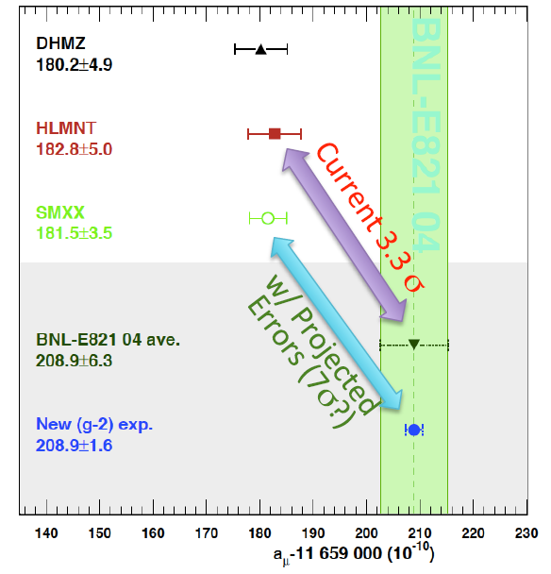
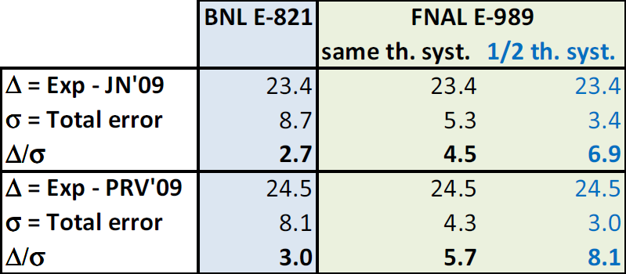
Potential scenarios (2014)
Potential scenarios (2016)
View from E-989
Two assumptions on Had. LbL LO (x 10⁻¹⁰):
  11.6 ± 4.0: Jegerlehner, Nyffeler (2009) [JN’09]
  10.5 ± 2.6: Prades, de Rafael, Vainshtein (2009) [PRV’09]
FNAL E-989 assumes x2 on σ(e⁺e⁻ ◊had)/σ(e⁺e⁻ ◊μ⁺μ⁻)
Δ=(a_{exp}-a_{th})x10⁻¹⁰
27.0
7.6
3.6
27.0
4.3-4.5
6.3-6.0
27.0
3.0
9.0

Slide 14
Back to history
Measurements of g-2 started in 1957
Continuous evolution of technique until now

Slide 15
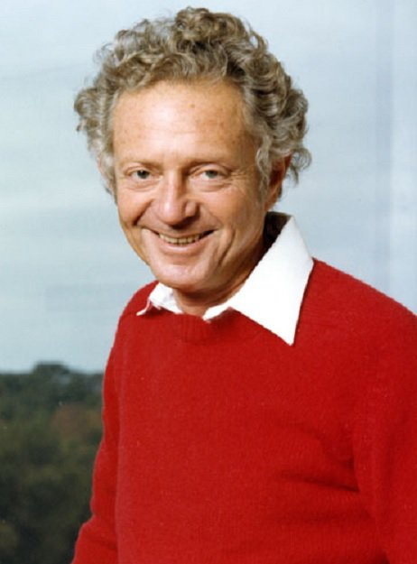
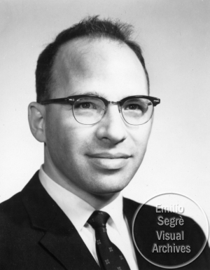
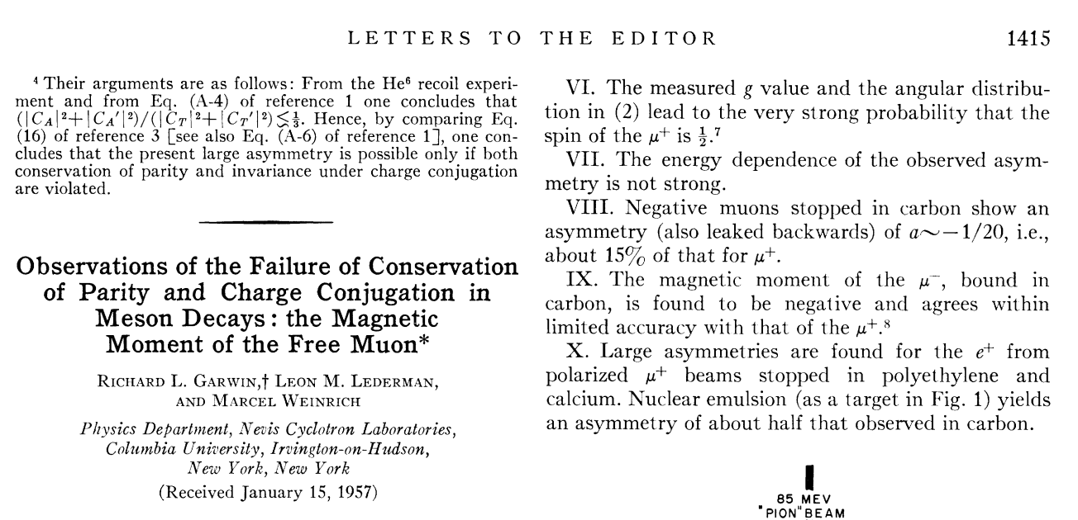
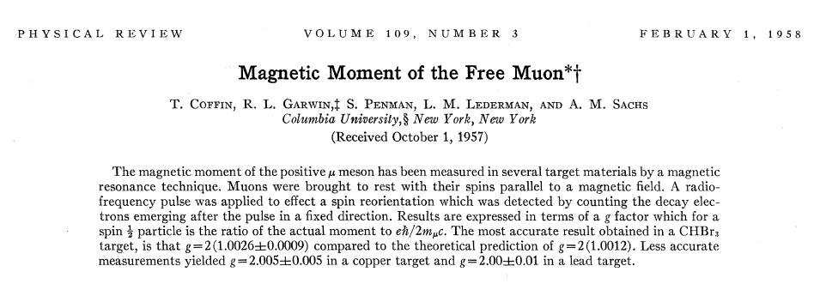
Garwin/Lederman (1957)
First experiments
  Magnetic resonance
g = 2.00±0.10
a_{μ} = 0.00113±0.000014

Slide 16
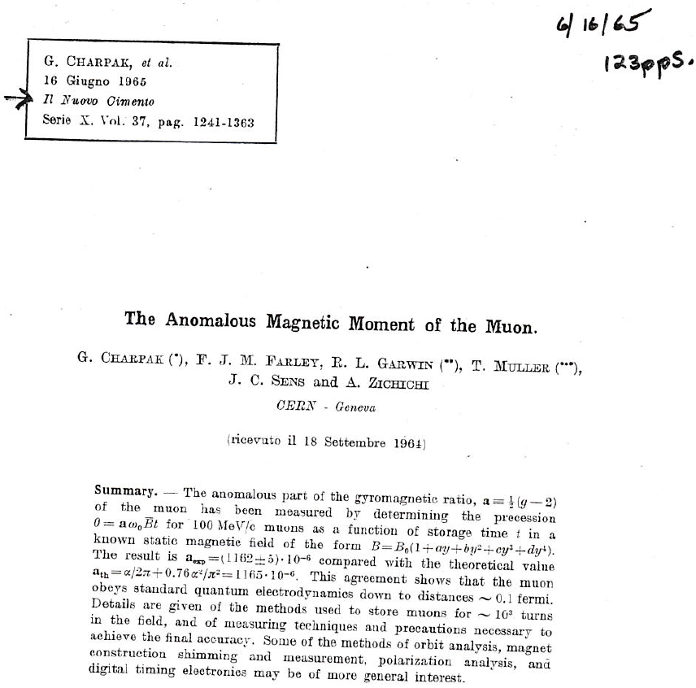
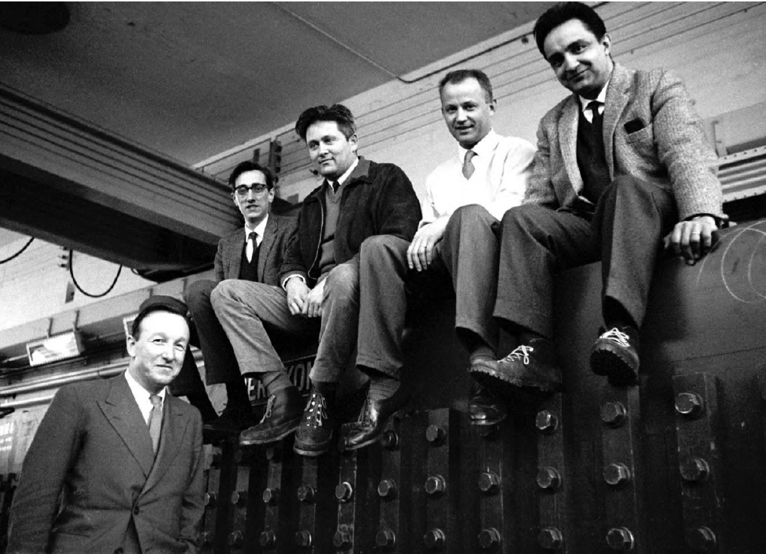
CERN-I (1964)
Precession in magnetic field
σ_{aμ}/a_{μ} = 1.9 → 0.43 %
Farley, Sens, Charpak, Muller, Zichichi
6-m g-2 magnet

Slide 17
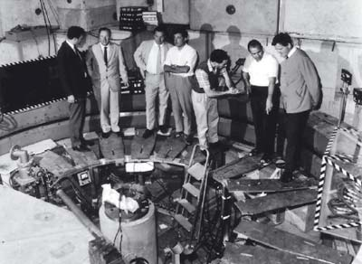
CERN-II-III (1968-1979)
CERN-II: muon storage ring → σ_{aμ}/a_{μ} = 265 ppm
CERN-III: magic mom./electr. quads → σ_{aμ}/a_{μ} = 7.3 ppm
S van der Meer, F J M Farley, M Giesch, R Brown, J Bailey, E Picasso and H Jöstlein

Slide 18
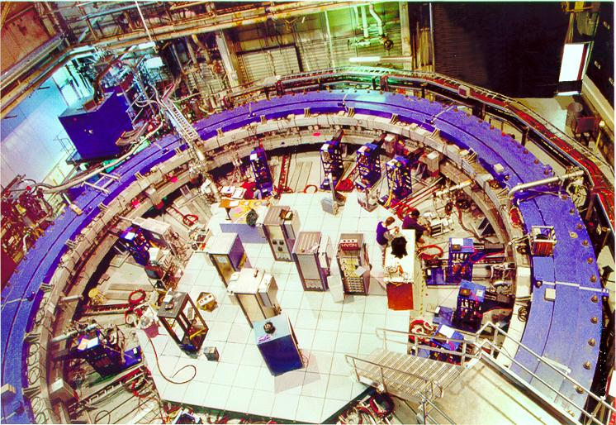
BNL-E821 (1997-2001)
Extremely good storage ring magnet! → B uniformity
AGS higher statistics then CERN → σ_{aμ}/a_{μ} = 5 → 0.5 ppm

Slide 19
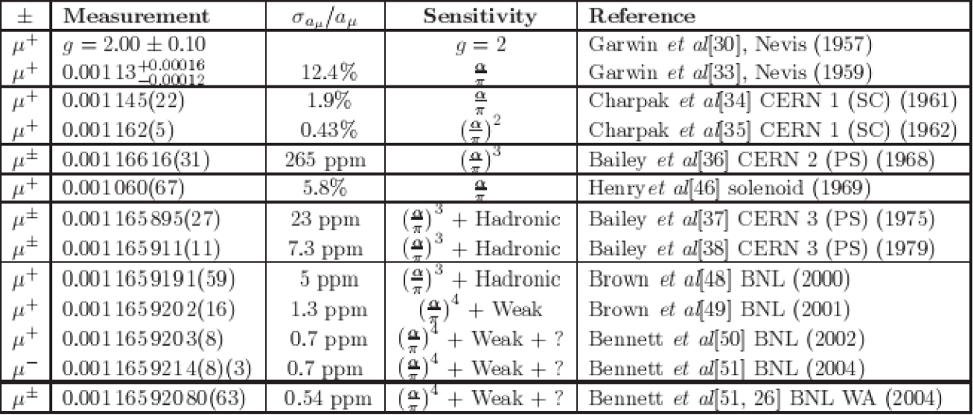
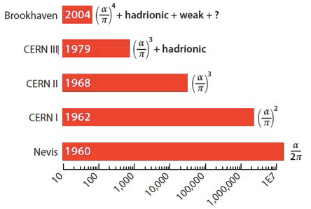
History of experiments
Summary

Slide 20
Future FNAL experiment
Ring magnet from BNL!
20x more muons
Much cleaner beam
Better calorimeter
Tracking stations added
Better B field measurements
Miscellaneous improvements on systematics
Plan for error ~ 0.14 ppm

Slide 21
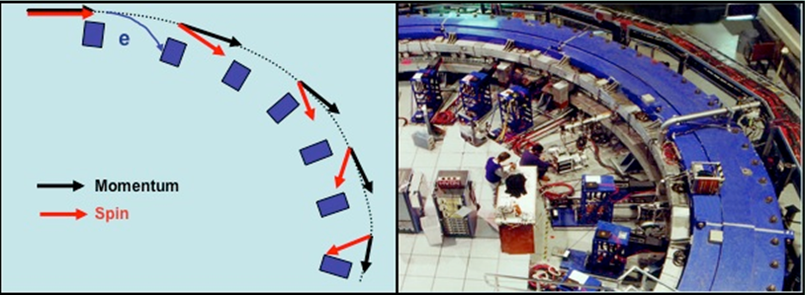
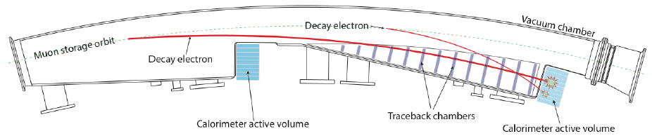
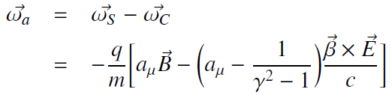
FNAL E-989: how it works
a_{μ} proportional to difference between precession and rotation frequency
Measure:
  ω_{a} e B
Tracking stations add much control over beam parameters
++ Electric dipole moment ++
Calorimeters
Magic momentum
3.094 GeV
γ=29.3
Notes:
Gamma*tau: mu 64.4 usec, pi+ 0.8 usec
Gamma*c*tau: mu 19,298 m, pi+ 229 m

Slide 22
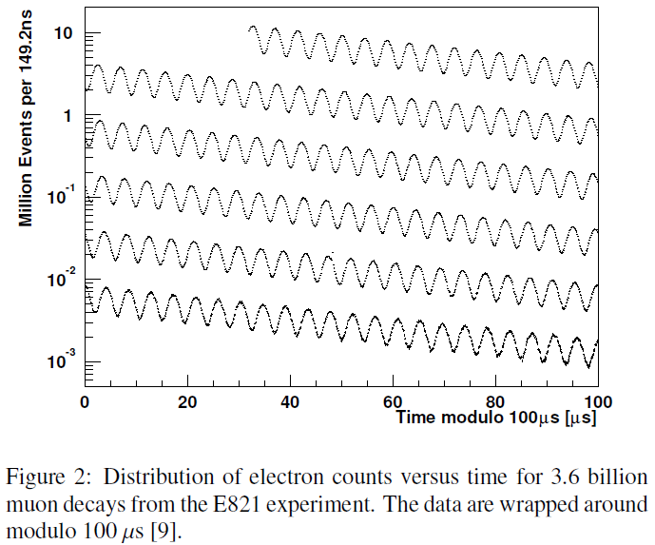
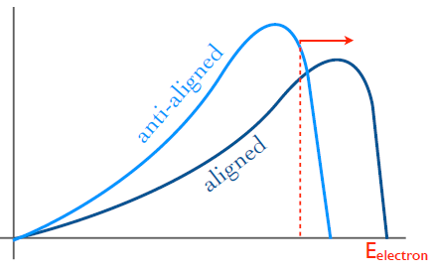

How it works: ω_{a}
Inject polarized muons into the ring
Observe decay electrons
  Count electrons above energy threshold (1.9 GeV optimal)
Harder electron spectrum when spin is aligned with momentum

Slide 23
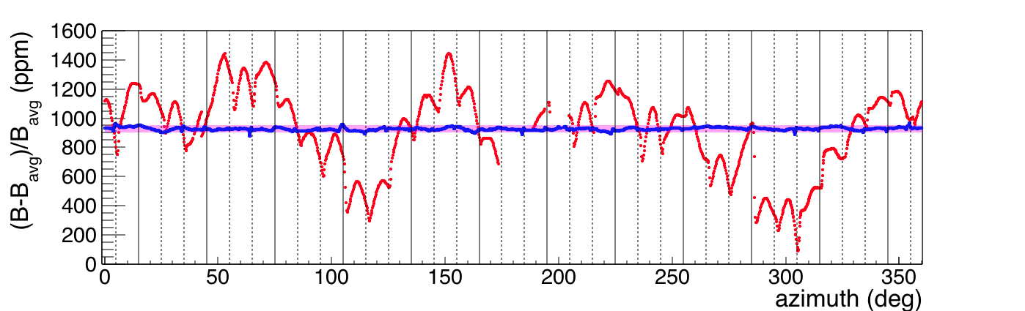
How it works: B/ω_{p}
B measured with NMR probes (precision ~10 ppb)→
  ω_{p} = free proton precession frequency ∝ B
  Probes in several fixed positions and on trolley that can move around the ring
    What matters is average field around ring
Oct 2015 → Aug 2016
Goal 50 ppm
~1400
ppm
~200
ppm

Slide 24
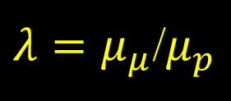

How it works: all together
The whole measurement is reduced to the measurement of two frequencies: ω_{a} and ω_{p}
  With a little math:
is the ratio of the magnetic moments of the muon and the proton
  Measured with 120 ppb (26 ppb indirect) precision with spectroscopy of muonic hydrogen like atoms (positive muon + electron) in a magnetic field monitored with NMR probes
$a_{μ}$ = $\frac{ω_{a}/ω_{p}}{λ−ω_{a}/ω_{p}}$
$λ=μ_{μ}$/$μ_{p}$
W. Liu et al, Phys. Rev. Lett. 82, 711 (1999)
S. Karshenboim and V. Ivanov, Can. J. Phys. 80, 1305 (2002)

Slide 25
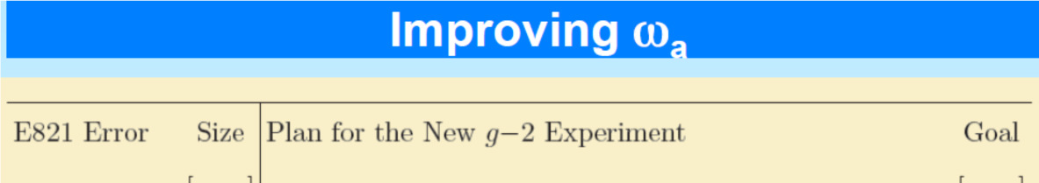


ω_{a} systematics
Β/ω_{p}
Most relevant: calorimeter gain variations
BNL
FNAL
Coherent Betatron Oscillations

Slide 26

B field systematics
Back
Mostly more and better probes/temperature stability
BNL
FNAL

Slide 27

FNAL muon beam
Muons
8 GeV Protons
asd
Pions
No hadronic flash
Pions all decay
Protons removed by a DR kicker
Forward muons collected
95% polarized
~800,000 μ⁺/fill (δP/P 2%) at ring
4 bunches

Slide 28


FNAL beam wrt. BNL
Beam improved recycling p-bar source:
  x20 total # muons
    x6-12 #muons/proton on target
    x4 fill frequency
  Statistical error on a_{μ}:
    5.4 x 10⁻¹⁰ → 1.2 x 10⁻¹⁰
  Removed pion flash
    L_{decay} 90 m → 2000 m
Fast muon kicker
  Turns off before one turn
Notes:
Vita media muone: 2.2e-6
Gamma*tau: mu 64.4 usec, pi+ 0.8 usec
Gamma*c*tau: mu 19,298 m, pi+ 229 m

Slide 29



Calorimetry (1)
24 stations
Fast:
  Crystals PbF₂
    Cherenkov
  SiPM readout
Laser calibration
  Reduce systematics

Slide 30


Calorimetry (2)
SLAC 2016
3 GeV beam
σ(E)/E ~ 3%
Energy resol. ~ 3%
  Optimized for good timing
Timing resolution
  25 ps intrinsic
  Digitizer bin 1.25 nsec
Pile up
  Resolve up to 4.5 ns separation
4.5 ns separation

Slide 31


Calibration system (1)
Light from 6 blue lasers distributed to all calorimeter cells
Source monitor: tracks laser intensity variations
Local monitor: tracks distribution chain variations

Slide 32



Calibration system (2)
1 laser ystem fully tested in 2016
  Frascati BTF
  SLAC
Raw 3 GeV e⁻
Source corrected
BTF@LNF
Laser corrected

Slide 33




Tracking system
3 x 8 module stations of straw tubes in stereo arrangement
  Measure muon profile
  Monitor lost muons
  Measure vertical pitch for EDM
Single straw radial resolution = 180 μm

Slide 34

Status and plan

Slide 35

Conclusions
The muon anomaly has great history and interest.
  Crucial test of higher order calc. and can signal new physics
  Lots of new theory work started including major lattice projects
Ring, detector and beam for planned FNAL experiment are progressing well
  Tracker and calorimeters under construction
  Installation in the ring ~ end of the year
This new experiment has injected many new ideas and improvements on top of a well established method
First results are close ..... just one year from now!!!
  ..but cross your fingers

Slide 36
Backup slides
more Slides

Slide 37


Correlation with μ→eγ
→back
g-2
μ→eγ

Slide 38

Misure di α_{EM}

Slide 39

Theory of g-2
Back

Slide 40

a_{μ} (QED)
Back

Slide 41

a_{μ} (had) & a_{μ} (EW)
Back

